Slide 1

ReFood
No more waste

Slide 2

Agenda
The Theme
Backend
Frontend
Mobile
Conclusion
Notes:
Agenda
General Template Guidance: Information to help you make good presentations.
Standard / Static Slides: Some key Endava slides/lockups that, in general, should only be modified by marketing.
Template Slides: A selection of template slides for use in Endava presentations.
Larger Format Template Slides: Template slides with larger content.
Icon Library: A selection of hundreds of icons to use in Endava presentations.

Slide 3

1
The Theme
Notes:
General Template Guidance
Information to help you make good presentations

Slide 4


When it comes to our planet, there is sadly no shortage of man made problems
One issue we chose to aid is the food waste problem
Approximately one third of all food in Romania ends up in the trash or is unnecessarily wasted annually. This amount corresponds to about 2.55 million tons of food products
The discarded food combines with the already existing waste and begins a slow process of decomposition, which releases methane. Methane is one of the most powerful greenhouse gases, 28x stronger than carbon dioxide
Food waste also means water waste: a burger needs 2500 liters of water to be produced
The problem
Notes:
Concept slide (version 2)
Concept slides create “breathing room” in presentations by having white space and focusing on a few key details.
They are intended to represent important information, quotes, or Endava marketing messages to the audience.

Slide 5
How do we help?
Our little project exists to help our community with their food waste and reduce them as much as possible.
This is a big task that needs many steps to fulfill.
The first step we decided to make is to help businesses in minimizing the amount of great food they throw away each day by offering it to our users, thus making the customer happy, creating a possible loyal customer and reducing how much food end up thrown away to rot in a pile.
Remember that many giants of today started small in someone’s garage

Slide 6

2
Backend
Notes:
Chapter Intro Slide (version C)
This slide should be used at the beginning of each “chapter” of your presentation (as introduced in the Agenda slide) to keep the audience aware of their place in the story and to help break things up. Change the text and chapter number accordingly. If you do not need a sub-head (the smaller text), delete it. Use different backgrounds for different chapter titles, try not to repeat a background.
Very short presentations (< ~10 slides) may not need Chapter Intro Slides.
There are multiple versions of this template with various white and black background images starting on slide 10.

Slide 7
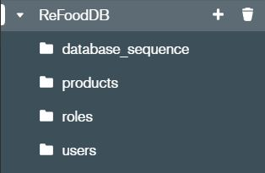
Project Structure and MongoDB collections
Project Structure
Model
Repository
Service
Controller
Configuration
Database Structure

Slide 8
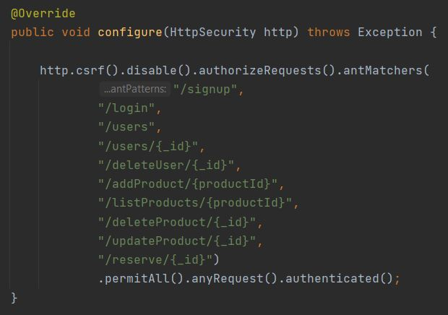
Controller API’s and Security Configuration
GET
POST
DELETE

Slide 9

3
Frontend
Notes:
Template Slides
A selection of template slides for use in Endava presentations.

Slide 10
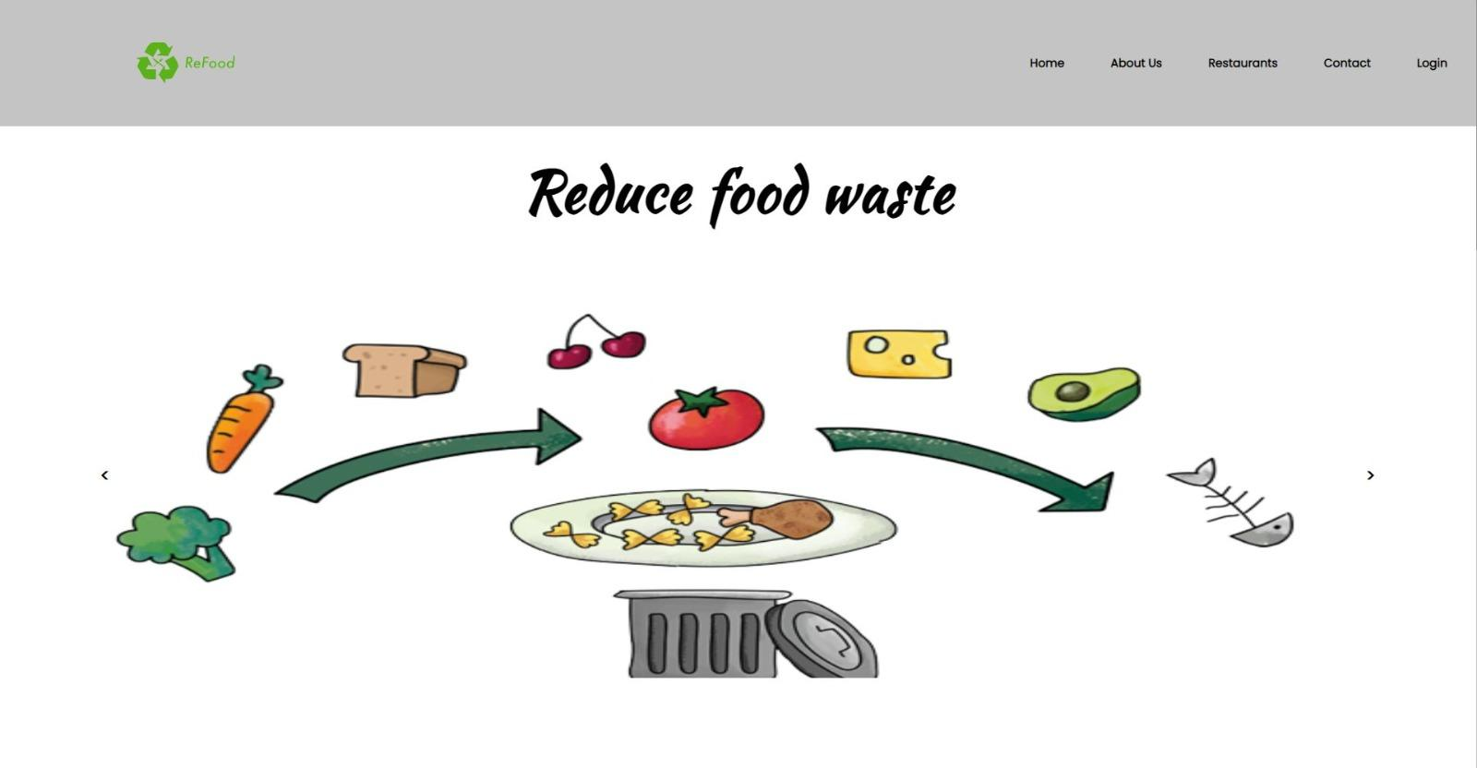
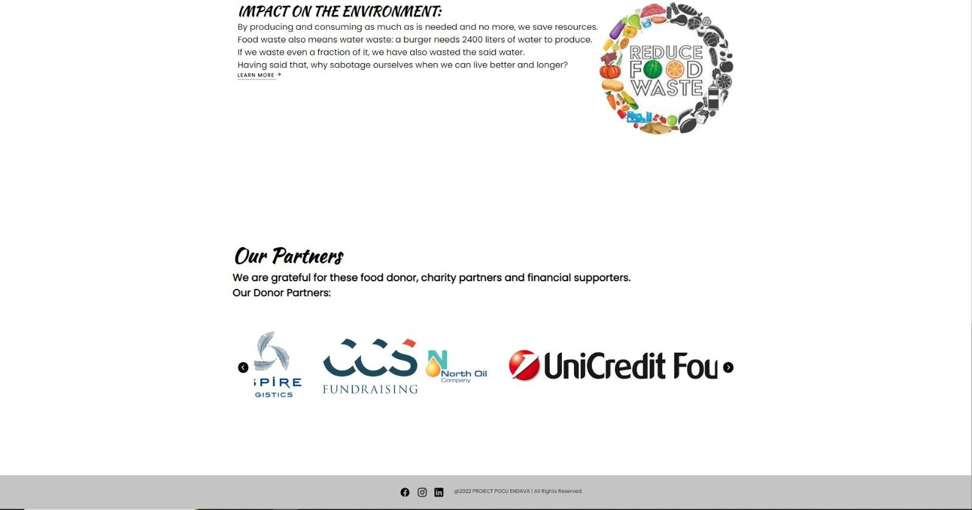
H Home page

Slide 11
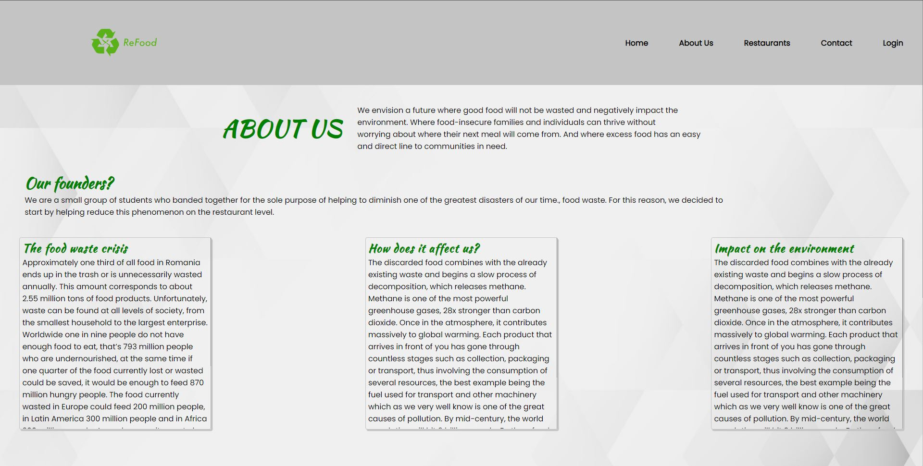
About Us Page

Slide 12
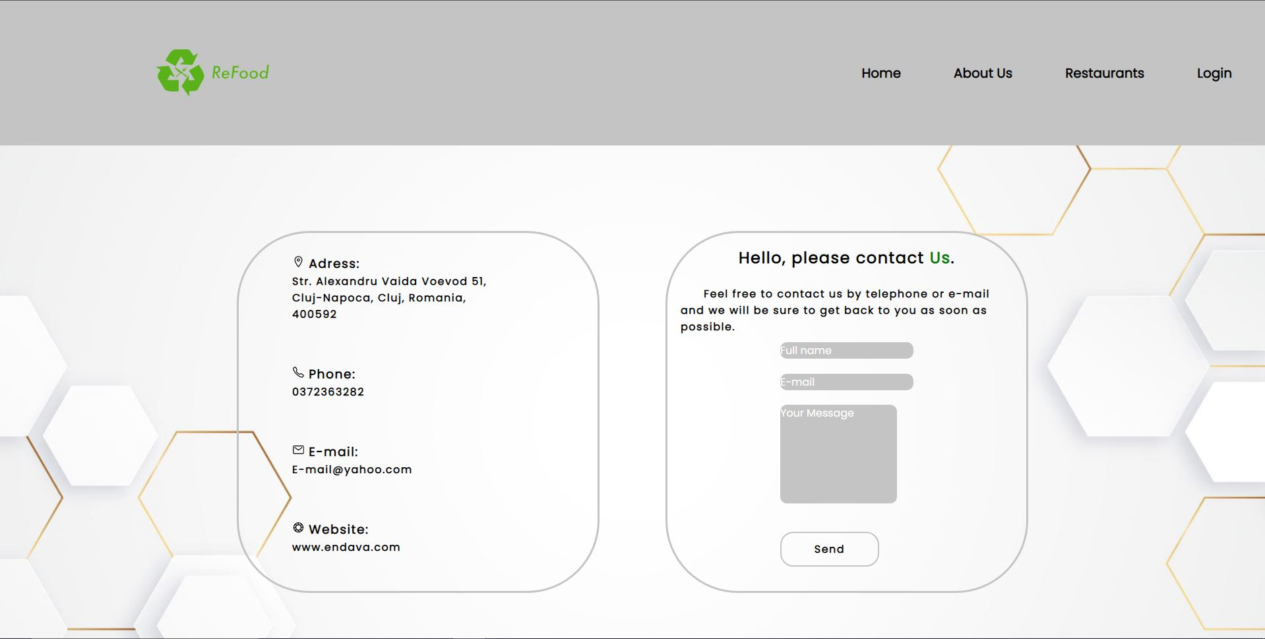
Contact Page

Slide 13
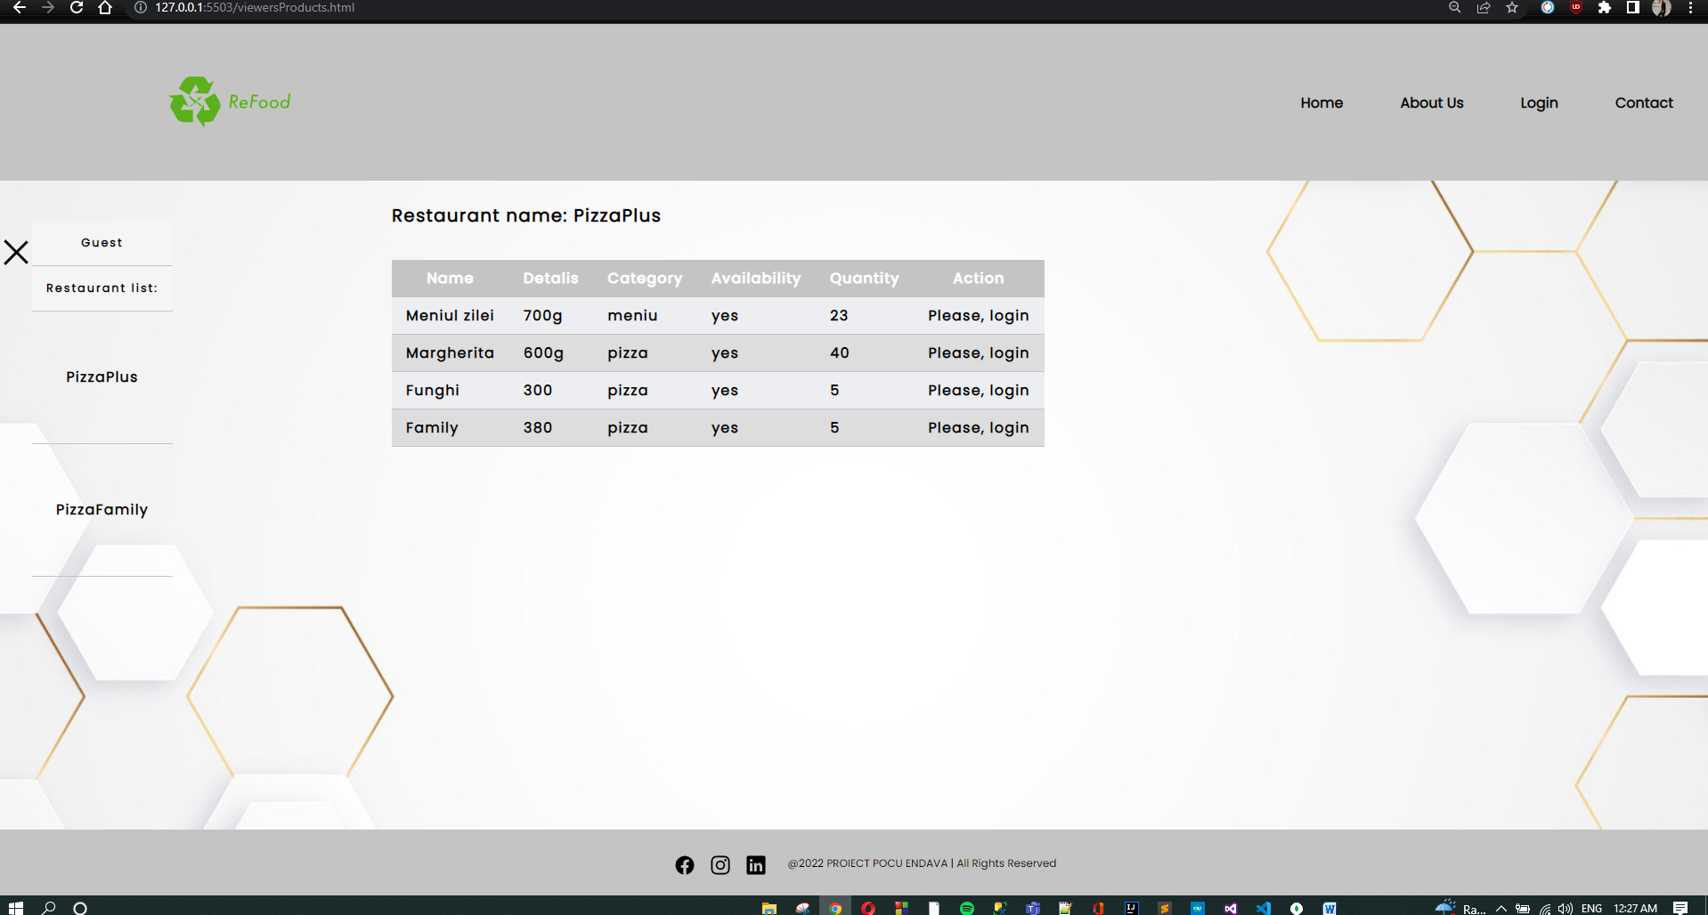
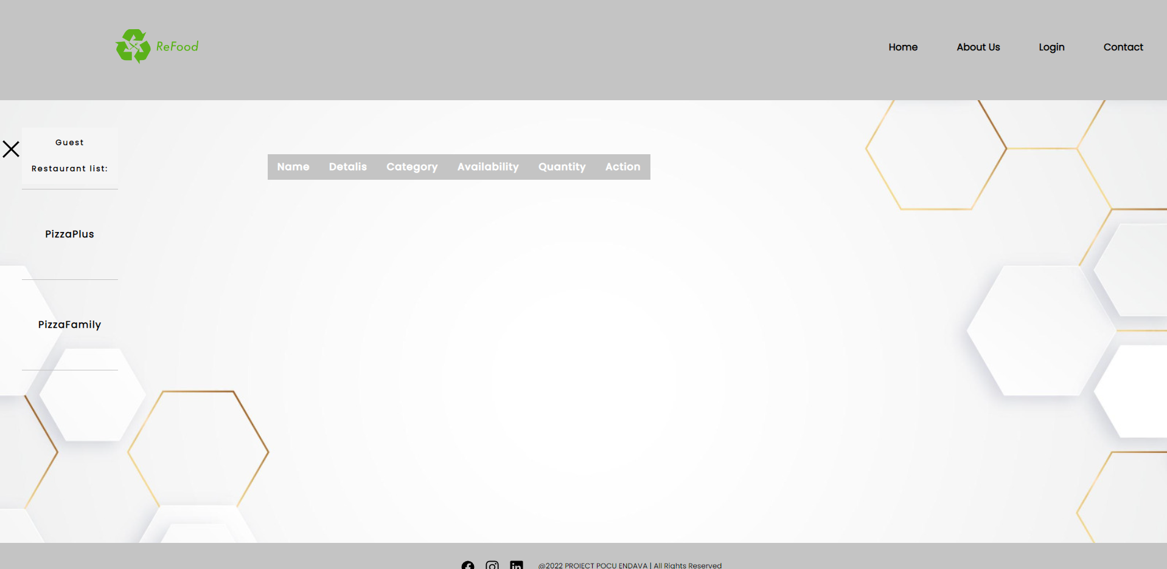
Guest, client & admin restaurants and products page.
Guest page

Slide 14
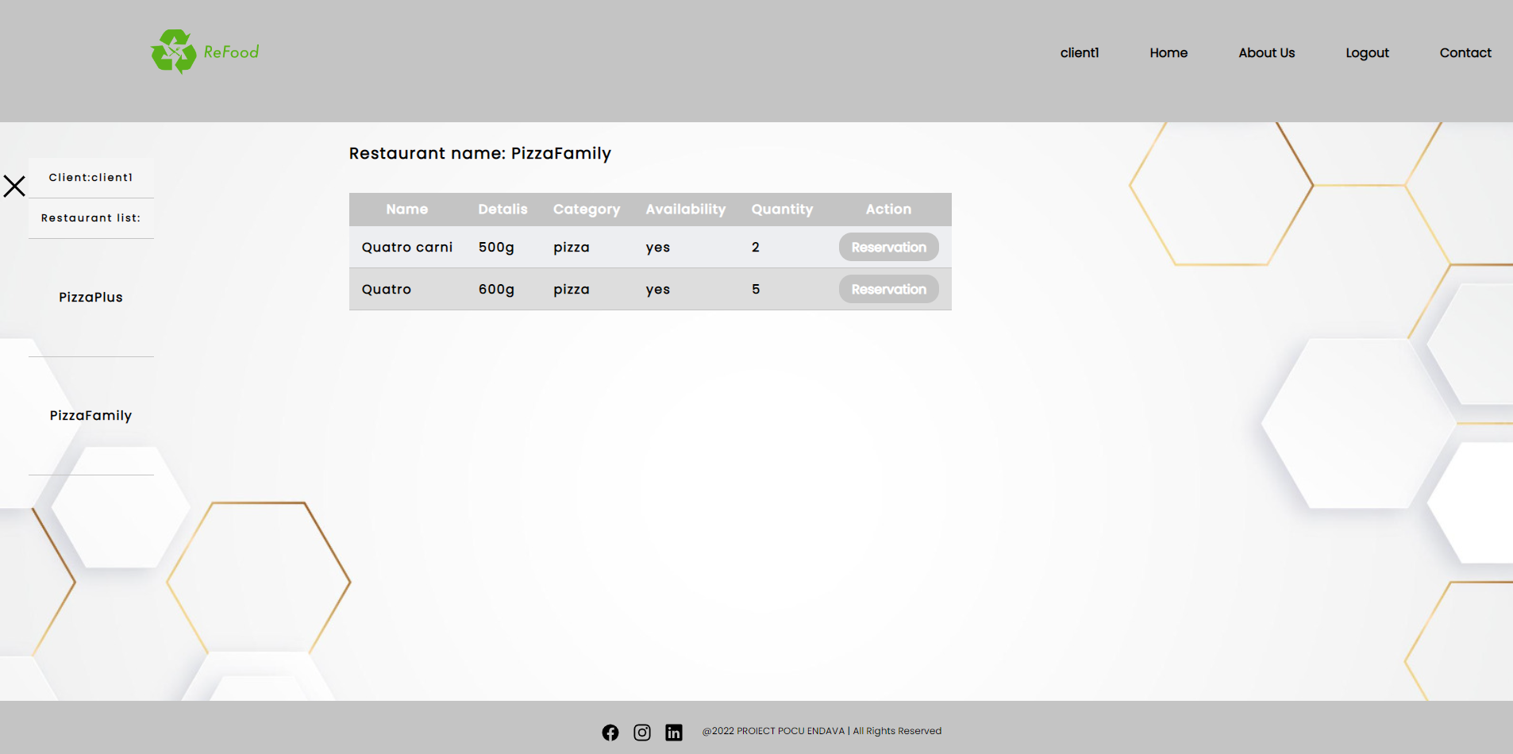
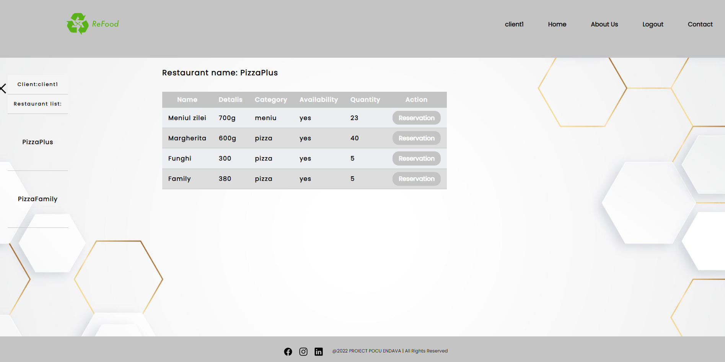
Guest, client & admin restaurants and products page.
Client page

Slide 15
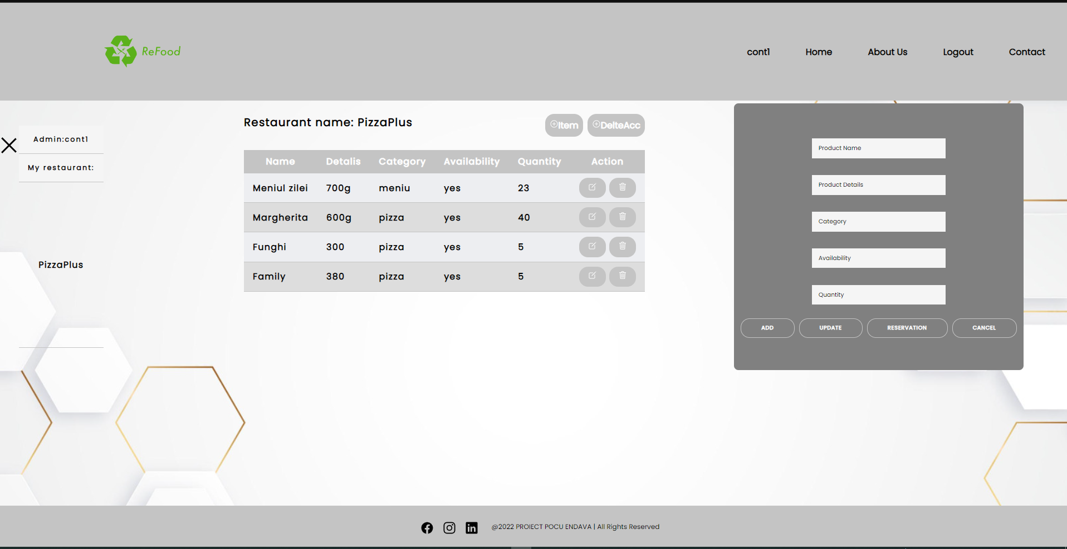
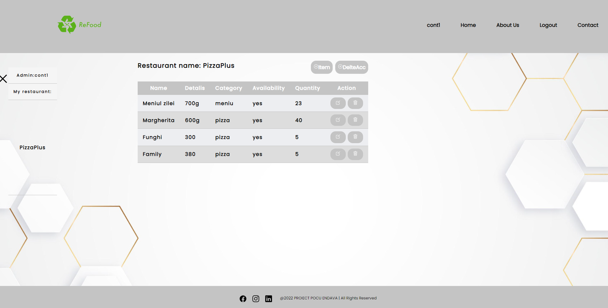
Guest, client & admin restaurants and products page.
Admin page

Slide 16

5
Conclusion
Notes:
Chapter Intro Slide (version H)
This slide should be used at the beginning of each “chapter” of your presentation (as introduced in the Agenda slide) to keep the audience aware of their place in the story and to help break things up. Change the text and chapter number accordingly. If you do not need a sub-head (the smaller text), delete it. Use different backgrounds for different chapter titles, try not to repeat a background.
Very short presentations (< ~10 slides) may not need Chapter Intro Slides.
There are multiple versions of this template with various white and black background images starting on slide 10.

Slide 17
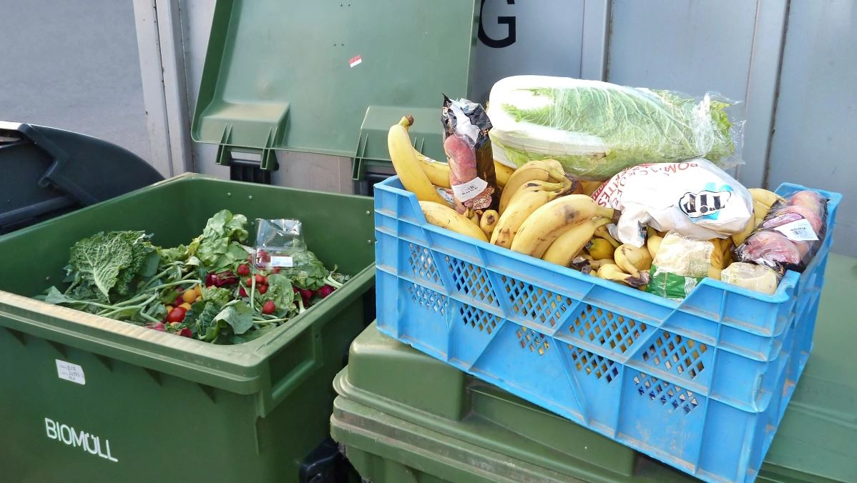
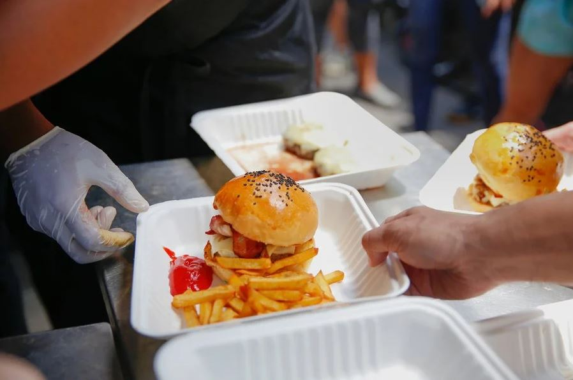
How is our app useful?
Our app offers restaurants an alternative against throwing out
good food
Almost 500.000 romanians are suffering from starvation
Restaurants have the opportunity to donate leftover food

Slide 18
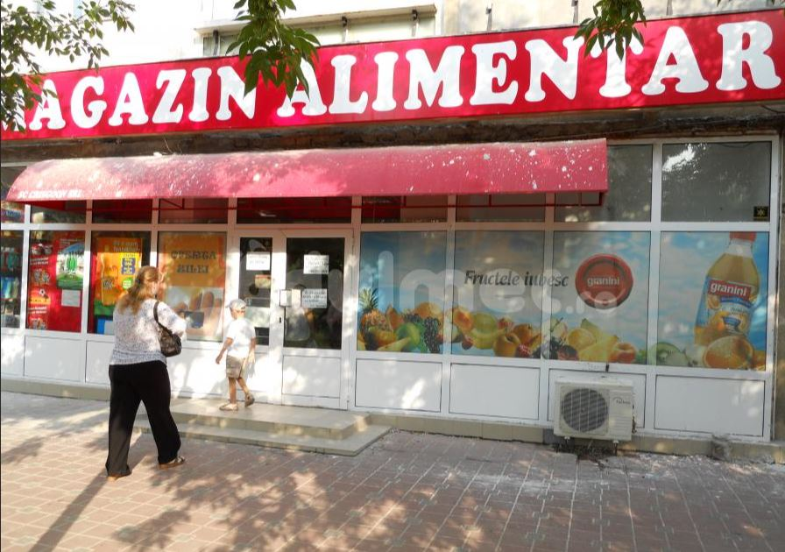
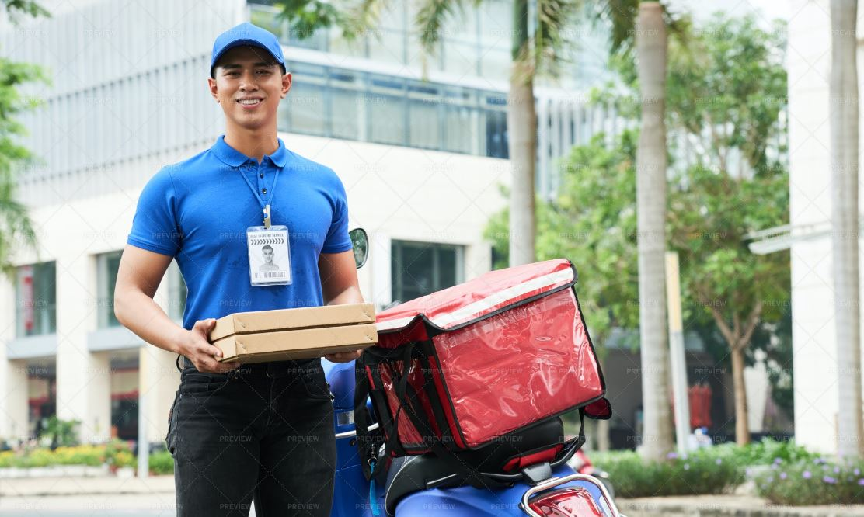
Future Features
Inclusion of stores, companies and farmers
Include delivery service

Slide 19
Backend:
Mircea Corbean
Frontend:
Erik Marius Inesc
Team
Members
Coordinator:
Nadia Maria Ancau

Slide 20


